Slide 1
Continuous Delivery voor Power BI
Yorick Bouma Martijn Veenvliet

Slide 2


Slide 3


Slide 4

Wie zijn wij?
Yorick Bouma
Martijn Veenvliet

Slide 5
Inhoud
Continuous Delivery
Continuous Delivery vopor Power BI
Demo
Terugblik

Slide 6
Continuous Delivery

Slide 7
Continuous Delivery

Slide 8
Continuous Delivery
Continuous Delivery is the ability to get changes of all types —including new features, configuration changes, bug fixes and experiments— into production, or into the hands of users, safely and quickly in a sustainable way.
https://continuousdelivery.com/

Slide 9
Continuous Delivery
Continuous Delivery is the ability to get changes of all types —including new features, configuration changes, bug fixes and experiments— into production, or into the hands of users, safely and quickly in a sustainable way.
https://continuousdelivery.com/

Slide 10
Continuous Delivery
Continuous Delivery is the ability to get changes of all types —including new features, configuration changes, bug fixes and experiments— into production, or into the hands of users, safely and quickly in a sustainable way.
https://continuousdelivery.com/

Slide 11
Continuous Delivery
Continuous Delivery is the ability to get changes of all types —including new features, configuration changes, bug fixes and experiments— into production, or into the hands of users, safely and quickly in a sustainable way.
https://continuousdelivery.com/

Slide 12
Continuous Delivery
Continuous Delivery is the ability to get changes of all types —including new features, configuration changes, bug fixes and experiments— into production, or into the hands of users, safely and quickly in a sustainable way.
https://continuousdelivery.com/

Slide 13
Continuous Delivery
Ideation
Design
Code
Build
Test
Release
Run
Learn

Slide 14
Continuous Delivery
Vijf principes:
Inbouwen van kwaliteit
Kleine releases
Computers voeren repetitieve taken uit; Mensen lossen problemen op
Constant verbeteren
Iedereen is verantwoordelijk
Notes:
Inbouwen van kwaliteit
Voorbeeld: Uitgebreid testen van een nieuwe measure
Kleine releases
Voorbeeld:
Computers voeren repetitieve taken uit; Mensen lossen problemen op
Voorbeeld: Releasen van deployments is een repetitieve taak, dus deze taak moet de computer uitvoeren. Het ontwikkelen van een rapportage is het oplossen van een problem, dus deze taak is voor de mens.
Constant verbeteren
Voorbeeld: Het verbeteren van het process of een business transformative is niet een project, maar het is een constant process waarbij je focust op het verbeteren van de huidige omgeving.
Iedereen is verantwoordelijk
Voorbeeld: Als er een fout in een measure is gemaakt, dan is iedereen van het team verantwoordelijk voor deze fout. Het proces zou namelijk moeten afvangen dat deze fout wordt gemaakt en iedereen is verantwoordelijk voor het process.

Slide 15
Continuous Delivery
Combinatie met andere methodieken

Slide 16
Continuous Delivery
Combinatie met andere methodieken
OTAP
Ontwikkel
Test
Acceptatie
Productie

Slide 17
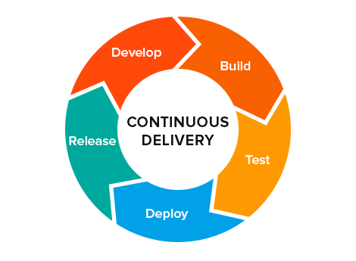
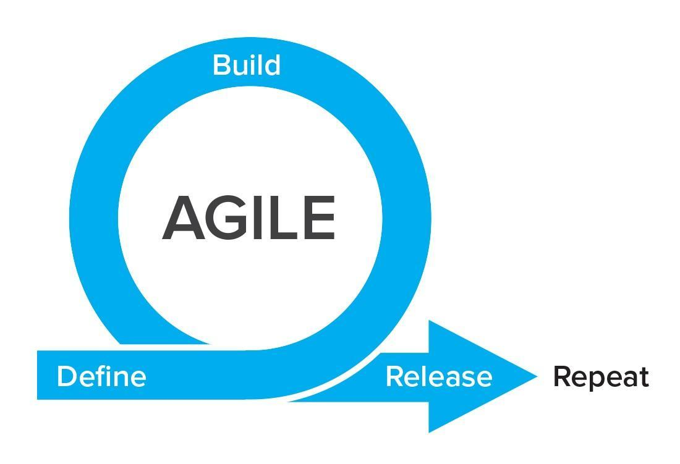
Continuous Delivery
Combinatie met andere methodieken
OTAP
Agile

Slide 18
Continuous Delivery for Power BI

Slide 19
What do we want to achieve?
Reports
Easily deploy new/updated reports
Automatically test reports
Workspaces
Easily create new/update existing workspaces
Easily add/remove users from/to workspaces
Approvals before going to Production
Above all… scalable!

Slide 20

Development Seat
Azure DevOps
Deployment Agent
PowerBI.com
Power BI Desktop
Repos
PowerShell
Workspaces
Visual Studio Code
Pipeline

Slide 21
Development Seat
Azure DevOps
Deployment Agent
PowerBI.com
Power BI Desktop
Repos
PowerShell
Workspaces
Visual Studio Code
Pipeline

Slide 22
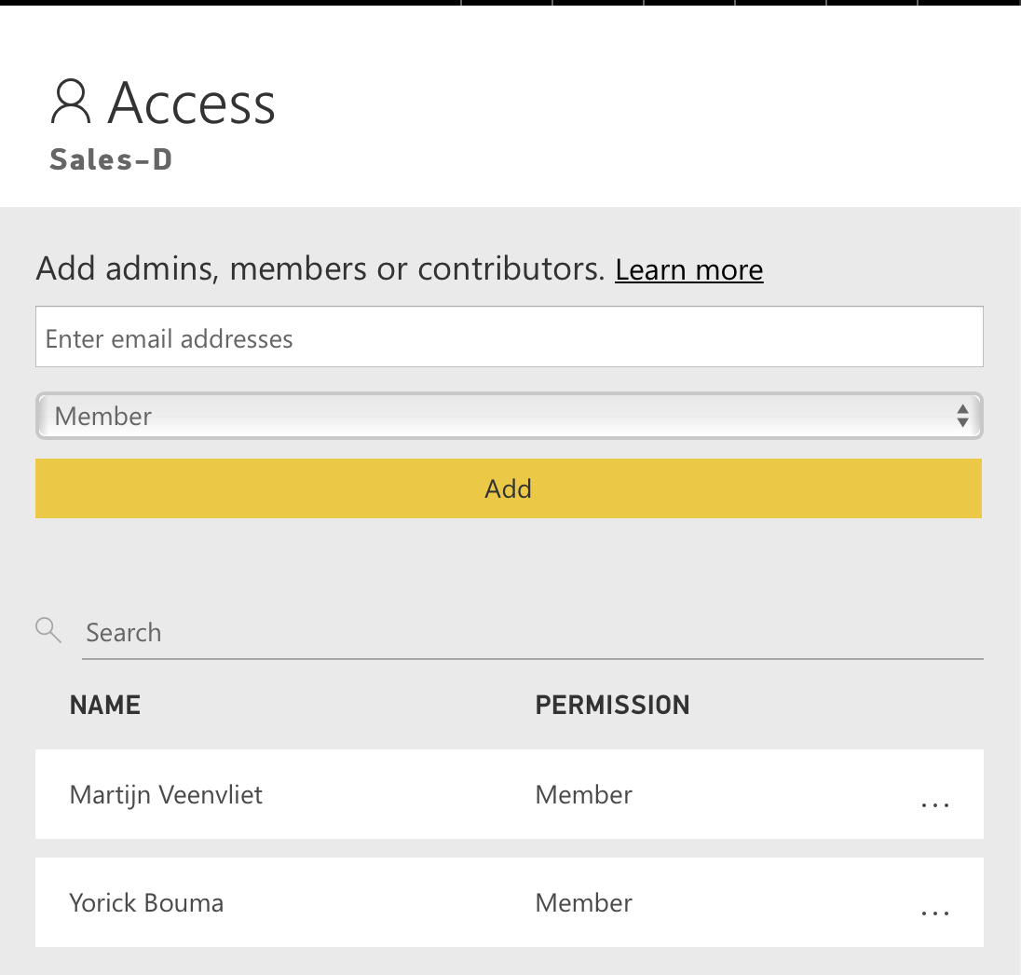
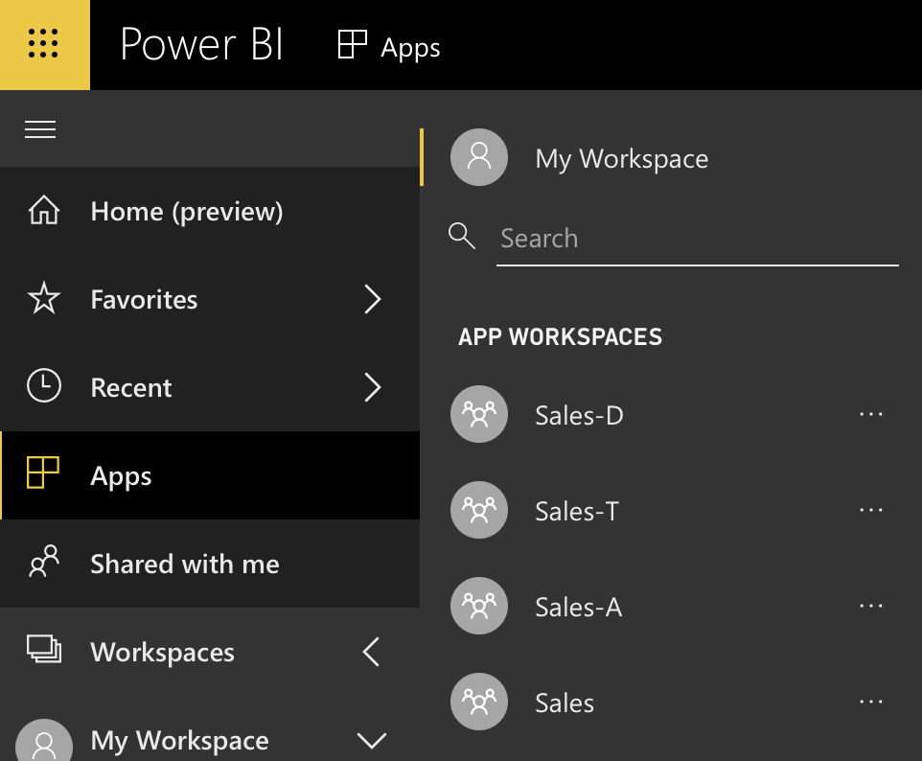
PowerBI.com

Slide 23
Development Seat
Reports
Power BI Desktop
ReportName.pbix
Visual Studio Code
ReportName.Publish.json
Workspaces
Visual Studio Code
WorkspaceName.Publish.json

Slide 24
Development Seat
Azure DevOps
Deployment Agent
PowerBI.com
Power BI Desktop
Repos
PowerShell
Workspaces
Visual Studio Code
Pipeline

Slide 25
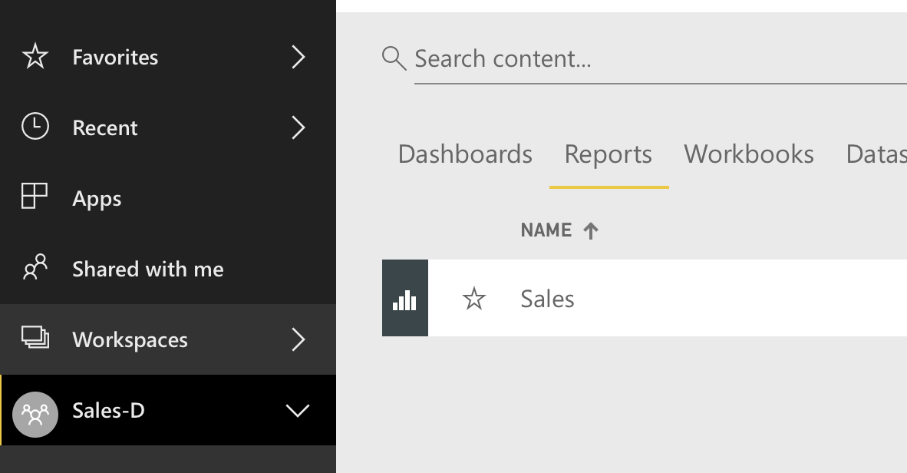
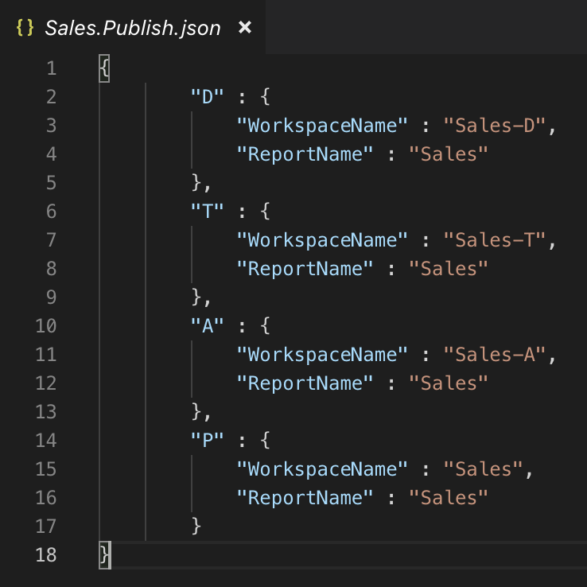
ReportName.Publish.json

Slide 26
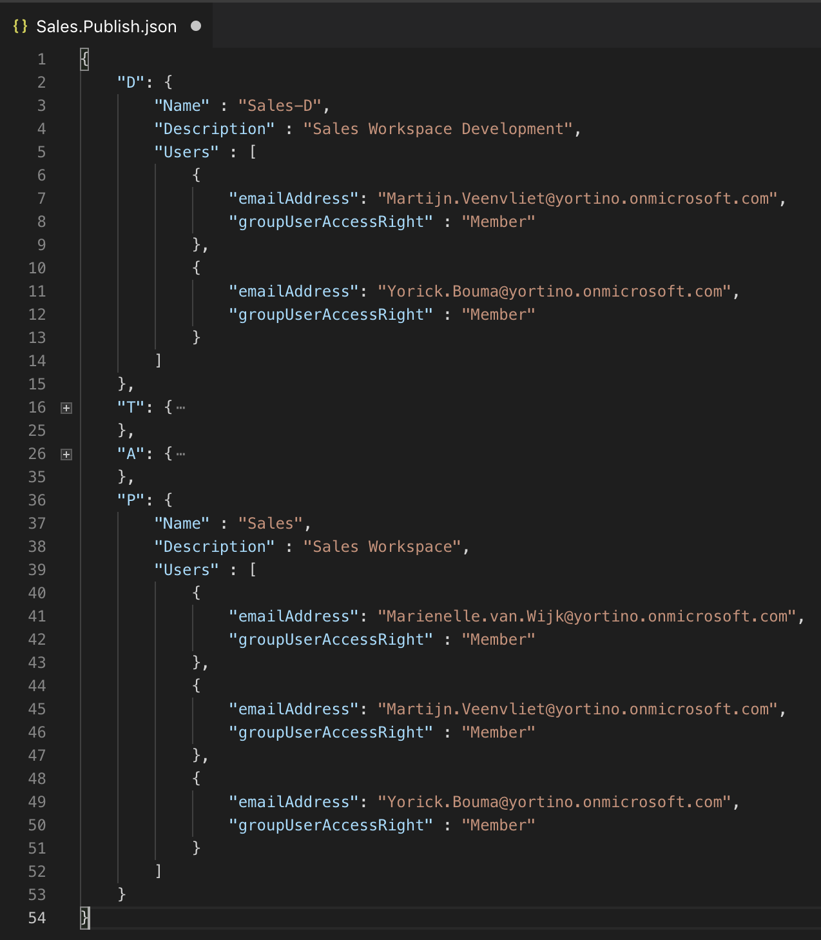
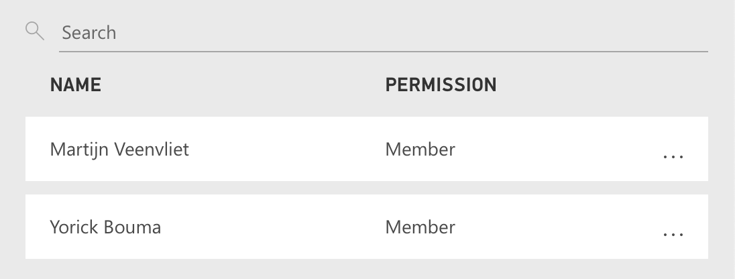
WorkspaceName.Publish.json

Slide 27
Development Seat
Azure DevOps
Deployment Agent
PowerBI.com
Power BI Desktop
Repos
PowerShell
Workspaces
Visual Studio Code
Pipeline

Slide 28
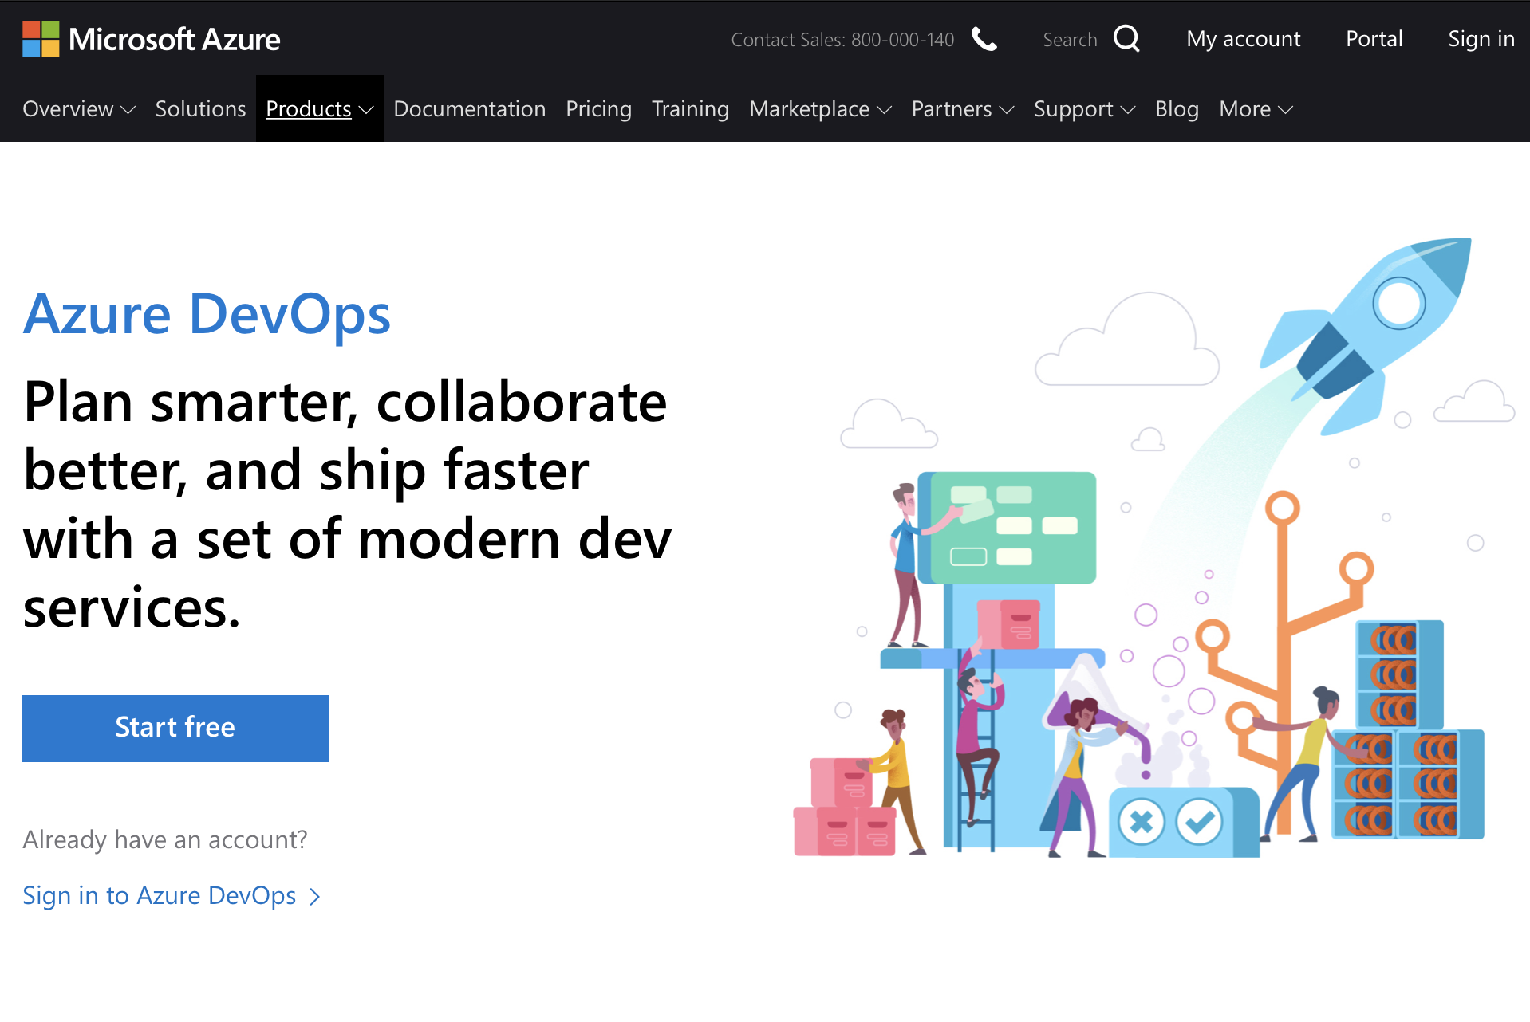
Azure DevOps

Slide 29
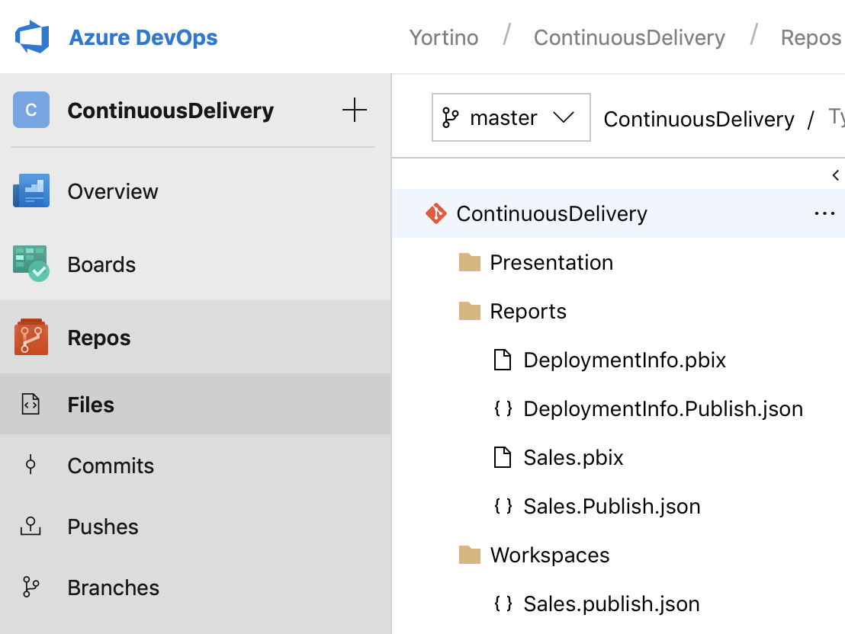
Repos
Reports
ReportName.pbix
Reportname.Publish.json
Workspaces
WorkspacesName.Publish.json

Slide 30
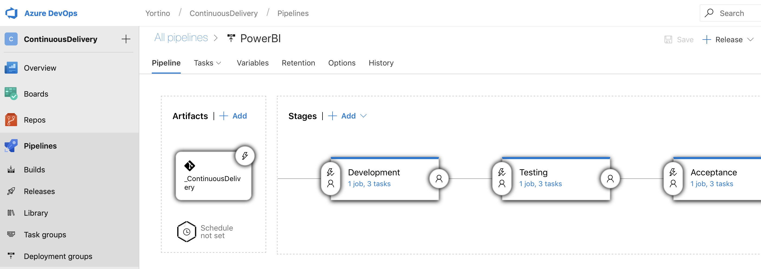
Pipeline

Slide 31
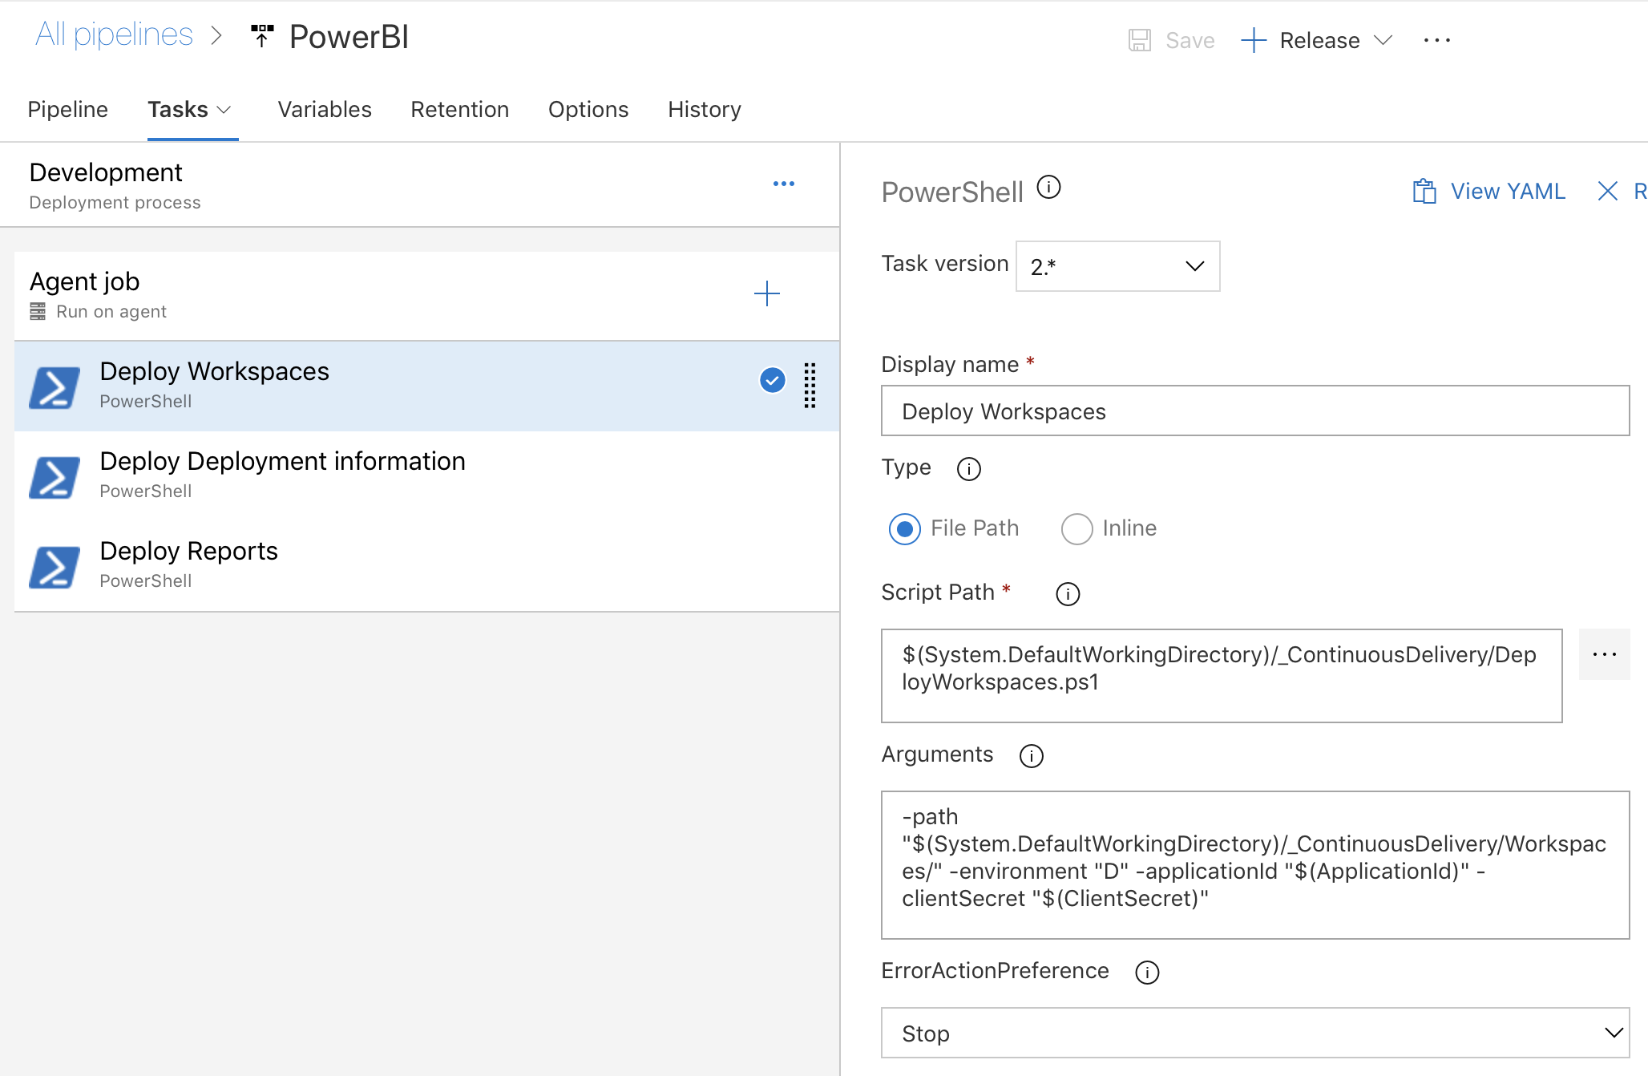
Pipeline – Tasks (Development)

Slide 32
Development Seat
Azure DevOps
Deployment Agent
PowerBI.com
Power BI Desktop
Repos
PowerShell
Workspaces
Visual Studio Code
Pipeline

Slide 33
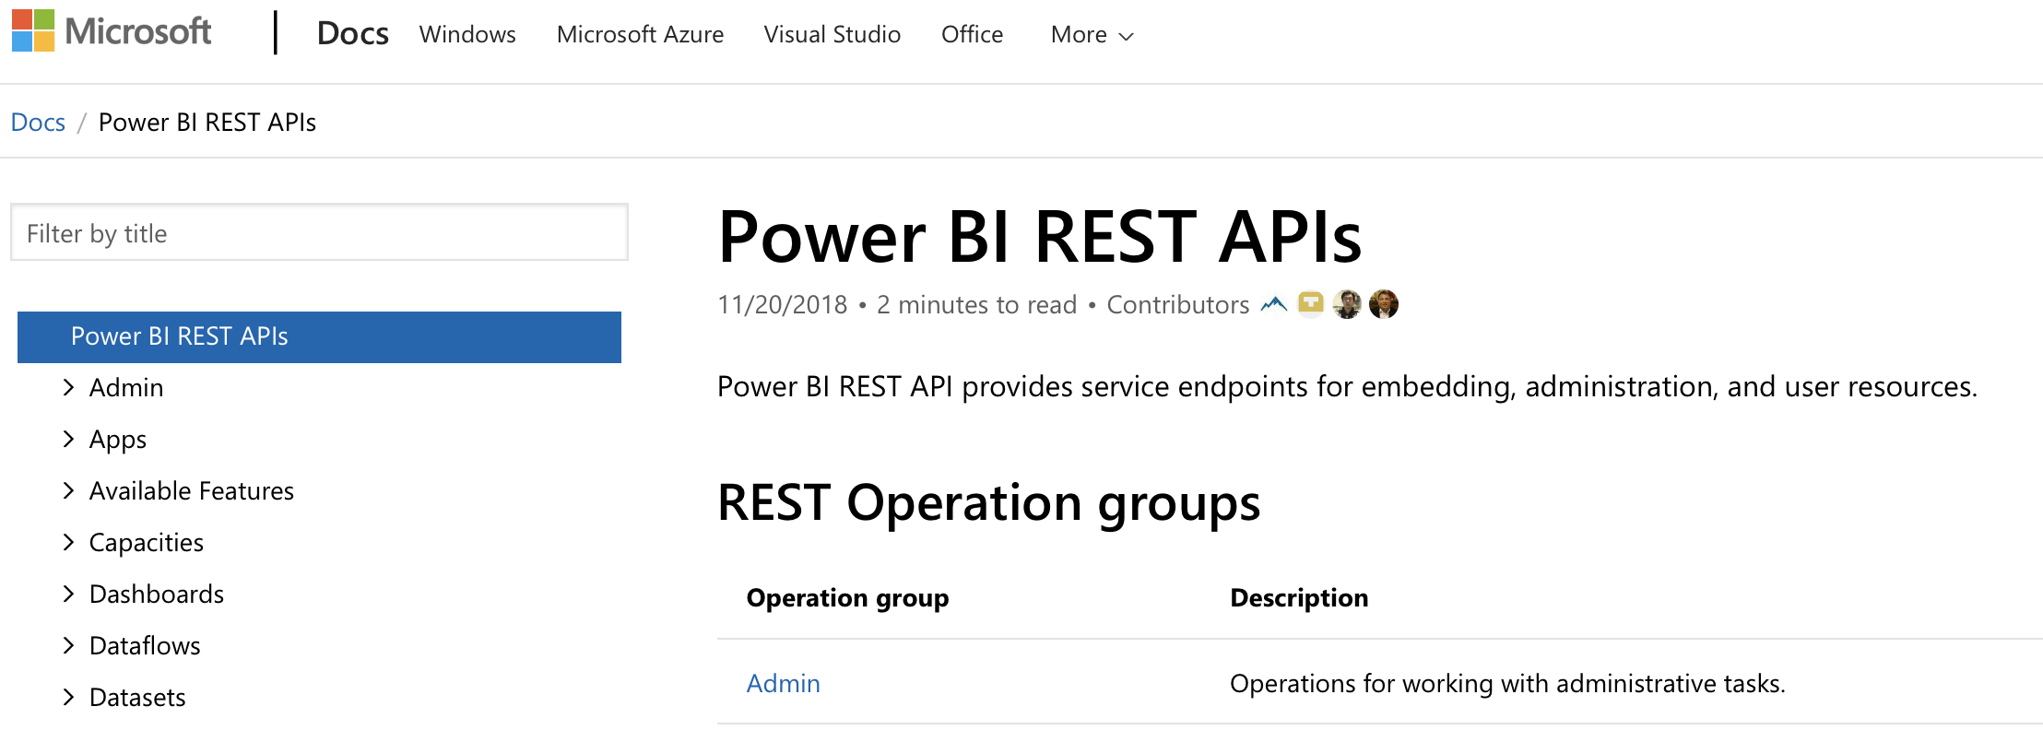
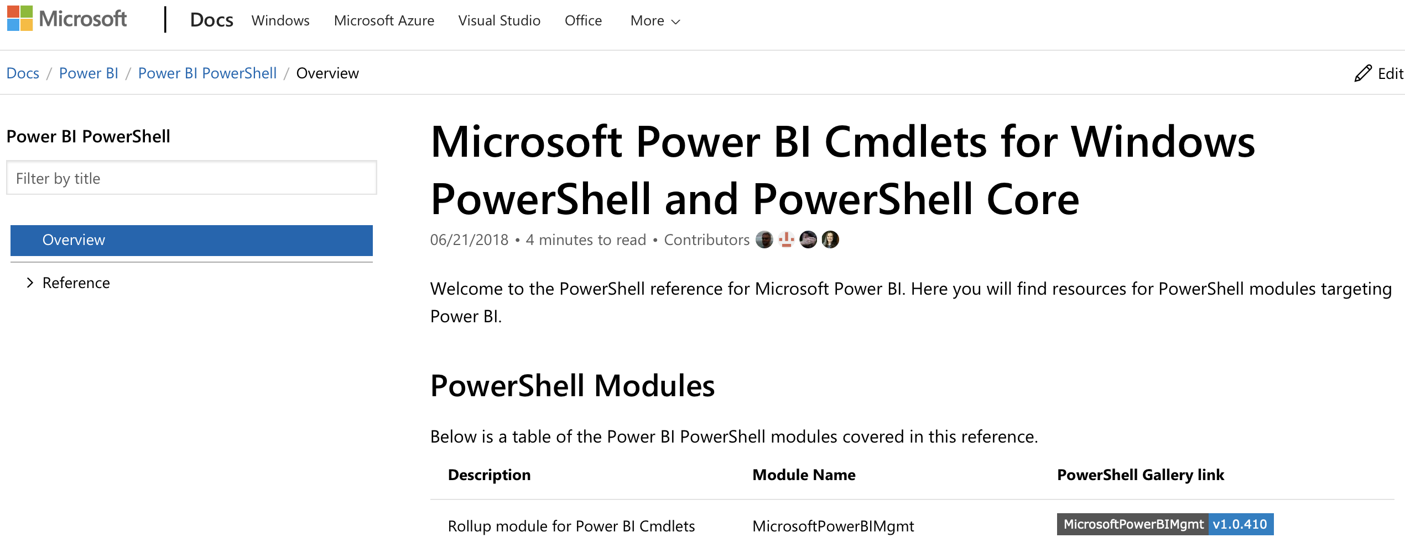
Deployment Agent
https://docs.microsoft.com/en-us/rest/api/power-bi/
https://docs.microsoft.com/en-us/powershell/power-bi/

Slide 34
Deployment Agent
PowerBI.com
Power BI Cmdlets
PowerShell
Power BI REST API
Workspaces

Slide 35
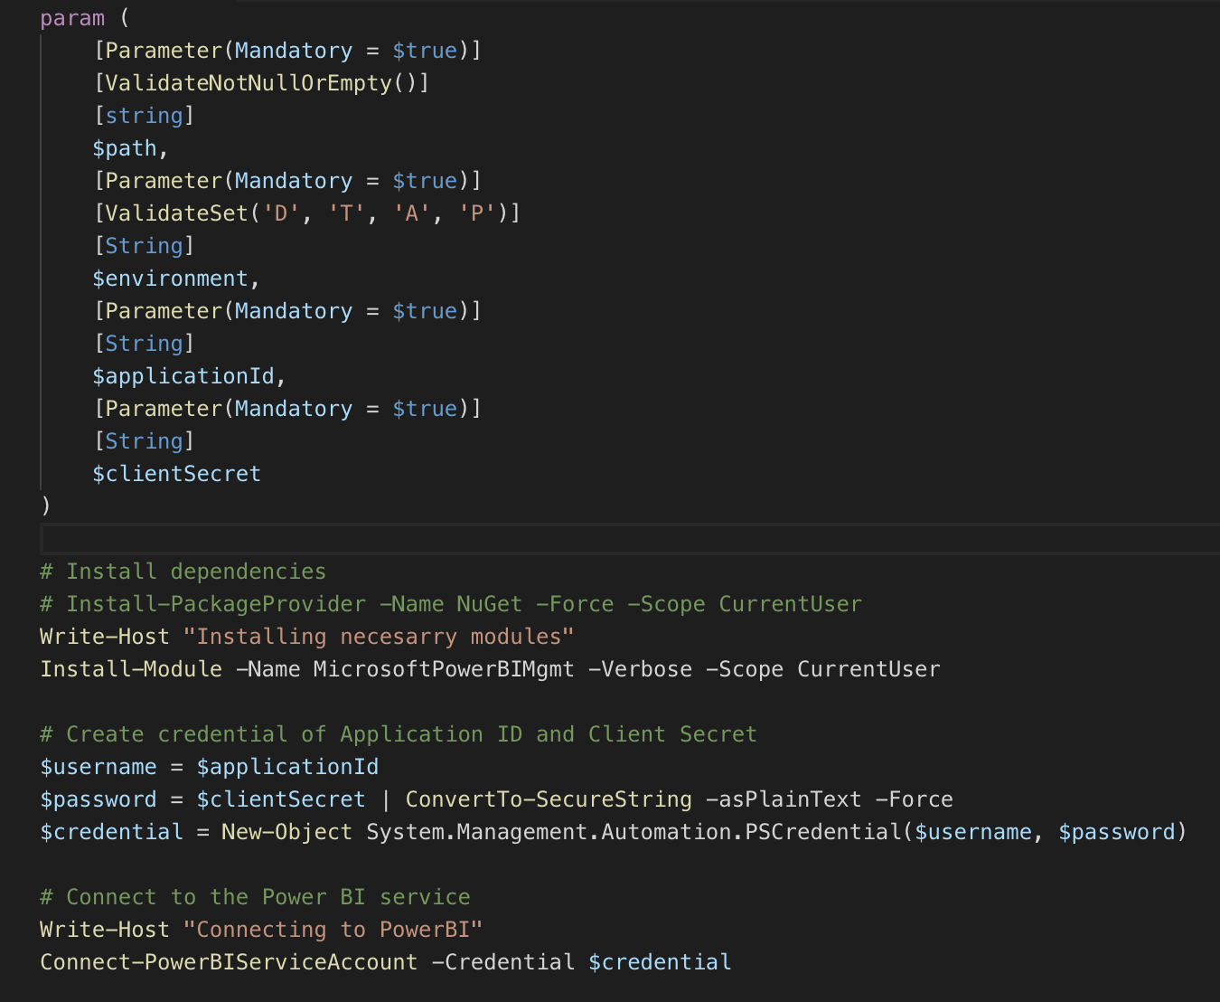
DeployReports.ps1
1. Process settings
2. Install Cmdlets
3. Create credentials
4. Connect to PowerBI.com

Slide 36
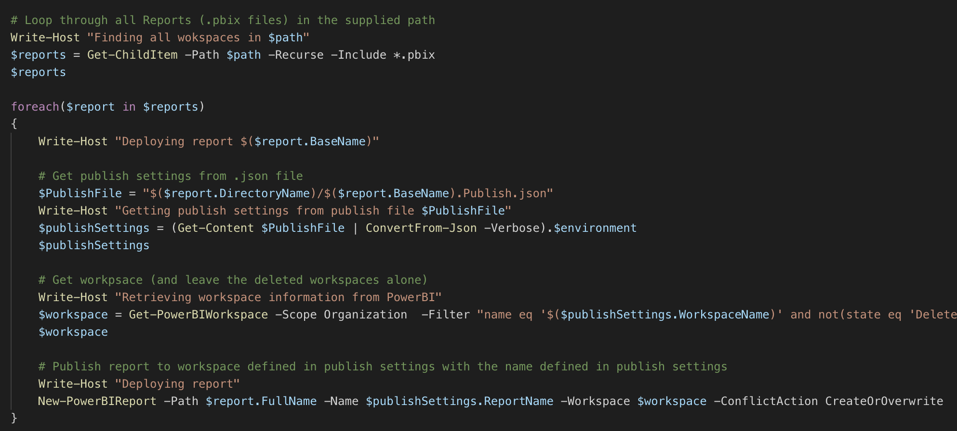
DeployReports.ps1
5. Get all reports to deploy from repo
6. Get report publish settings (Sales.Publish.json)
7. Find workspace to deploy to
8. Deploy

Slide 37
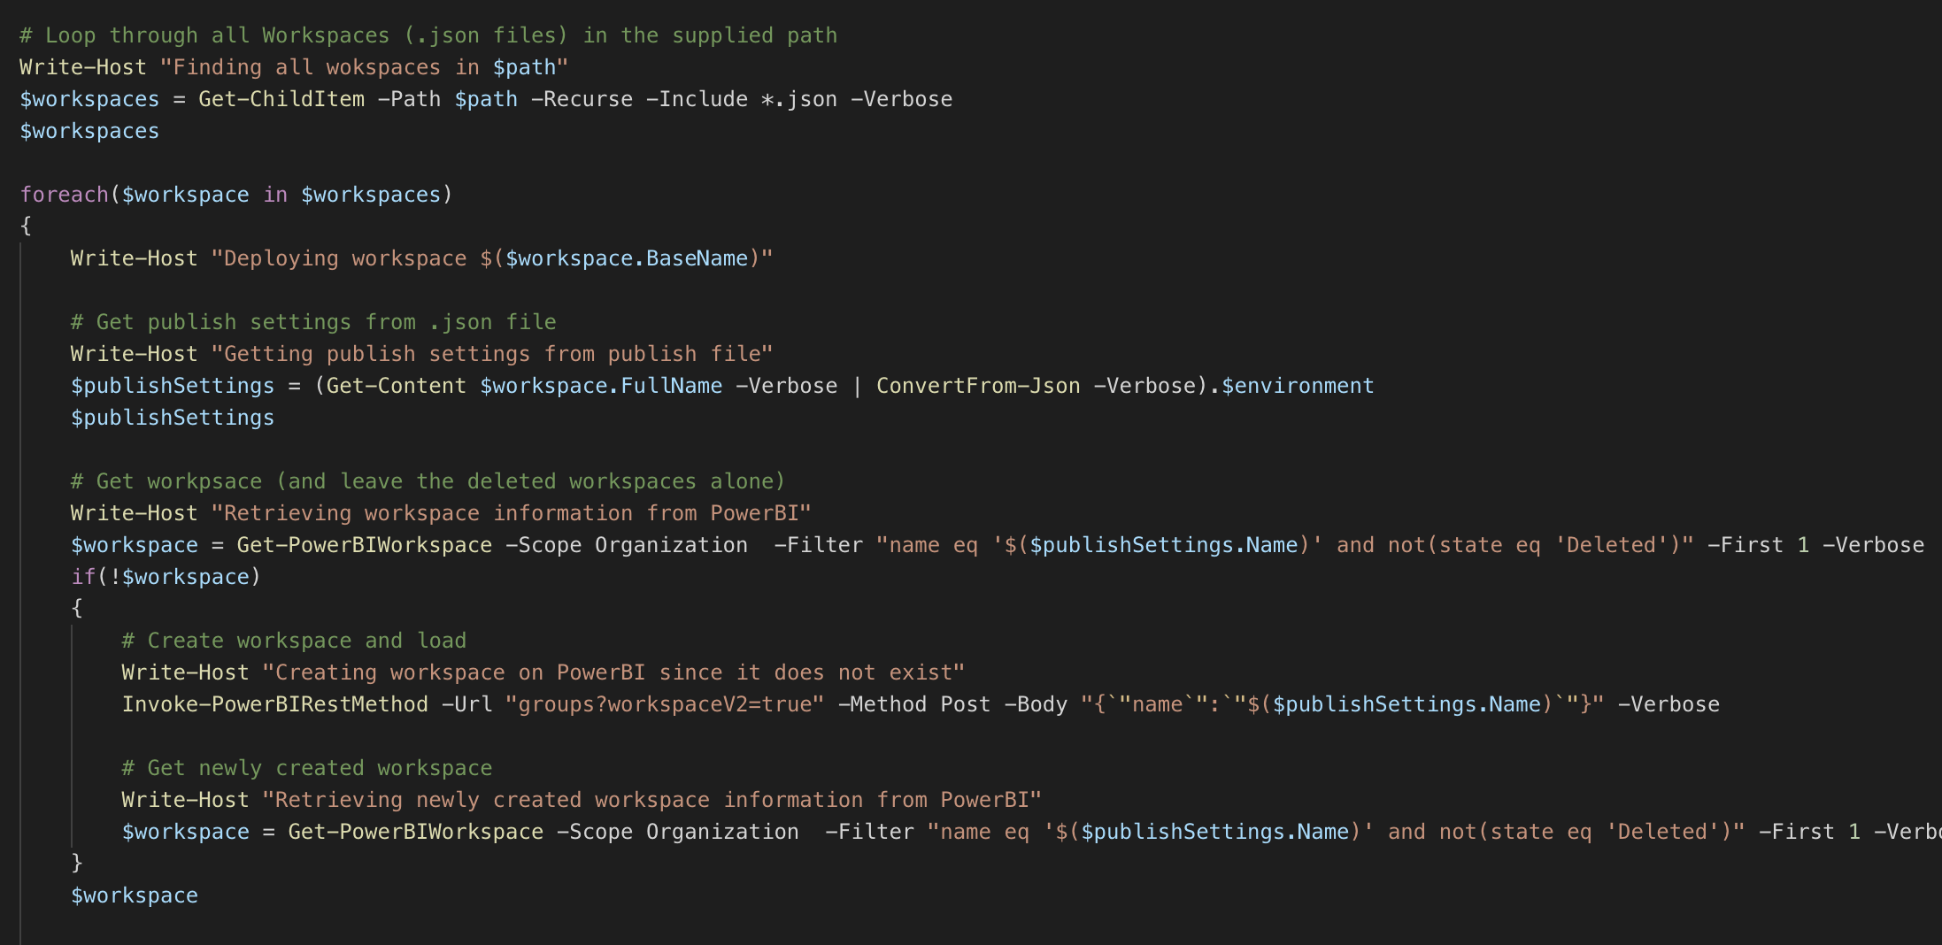
DeployWorkspaces.ps1
5. Get all workspaces to deploy from repo
6. Get workspace publish settings (Sales.Publish.json)
7. Create workspace if not exists

Slide 38
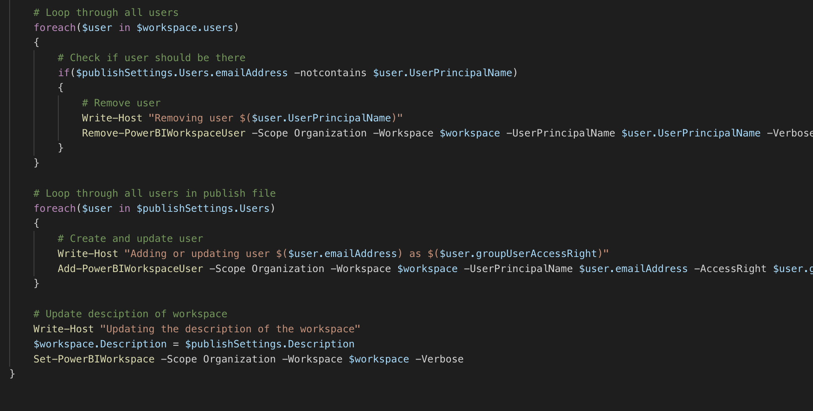
DeployWorkspaces.ps1
8. Remove users that should not be there
7. Create/update users that should be there
8. Update the description of the workspace

Slide 39
What did we achieve?
Reports
Easily deploy new/updated reports
Automatically test reports
Workspaces
Easily create new/update existing workspaces
Easily add/remove users from/to workspaces
Approvals before going to Production
Above all… scalable!

Slide 40
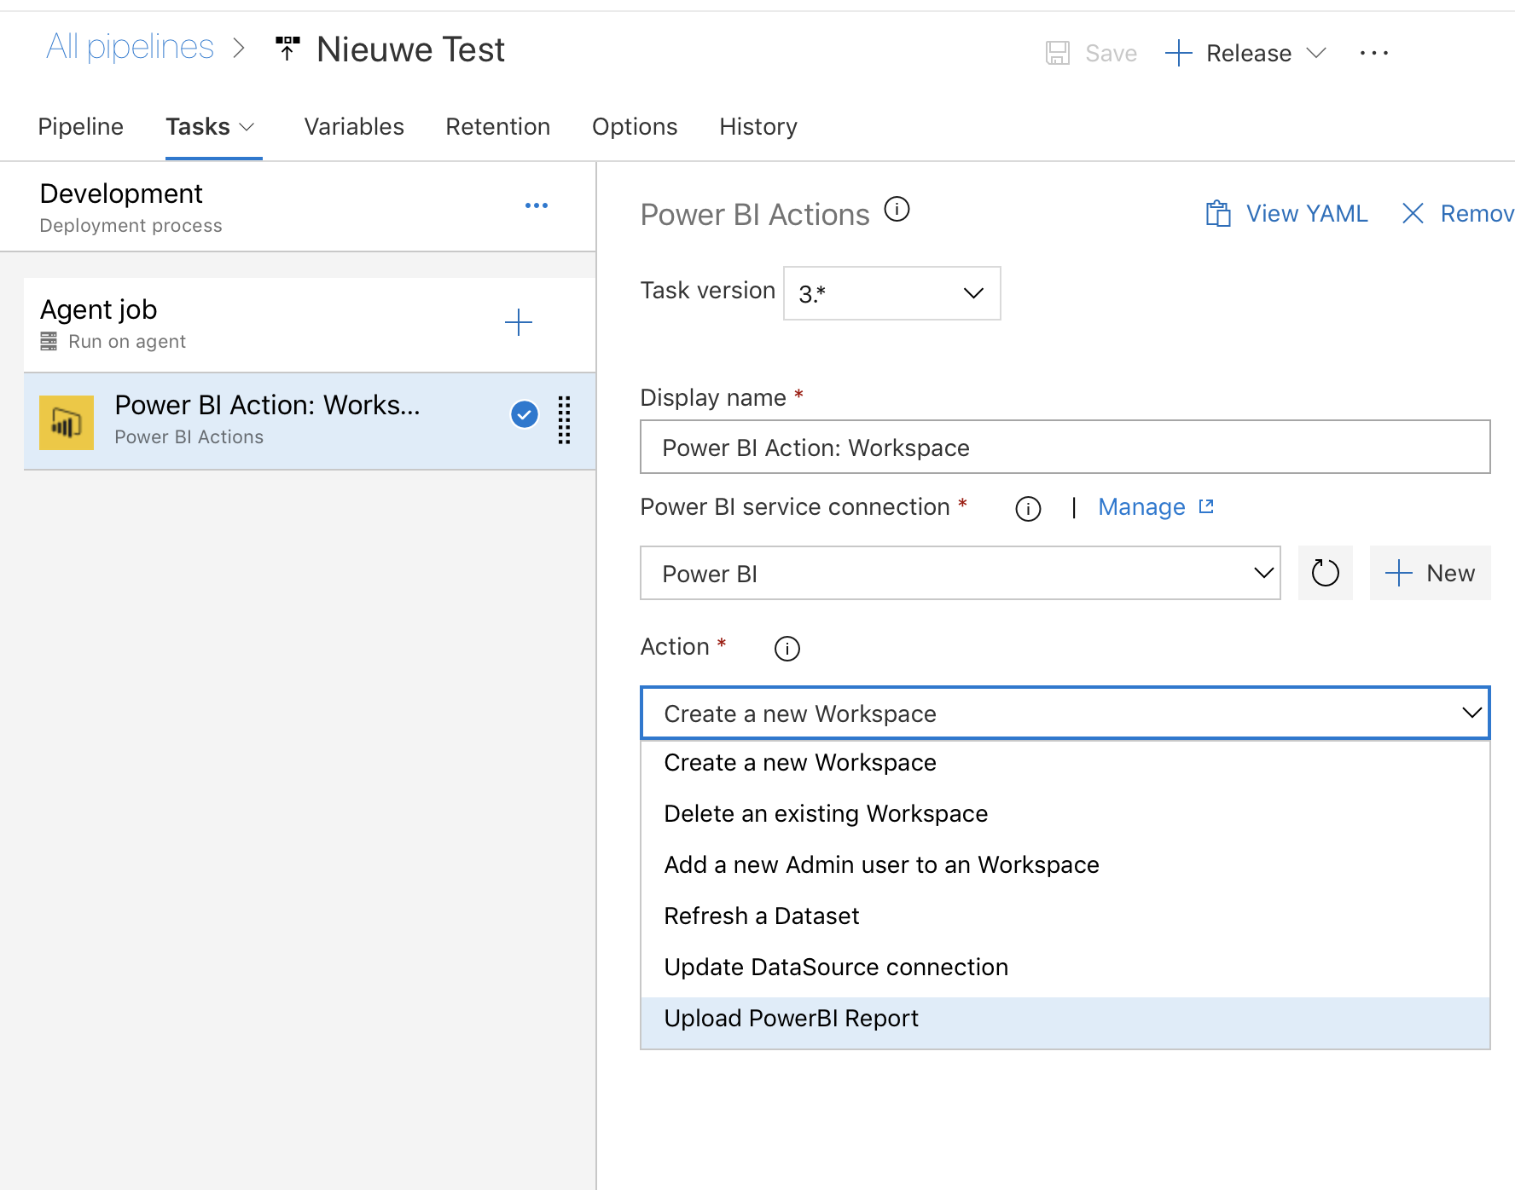
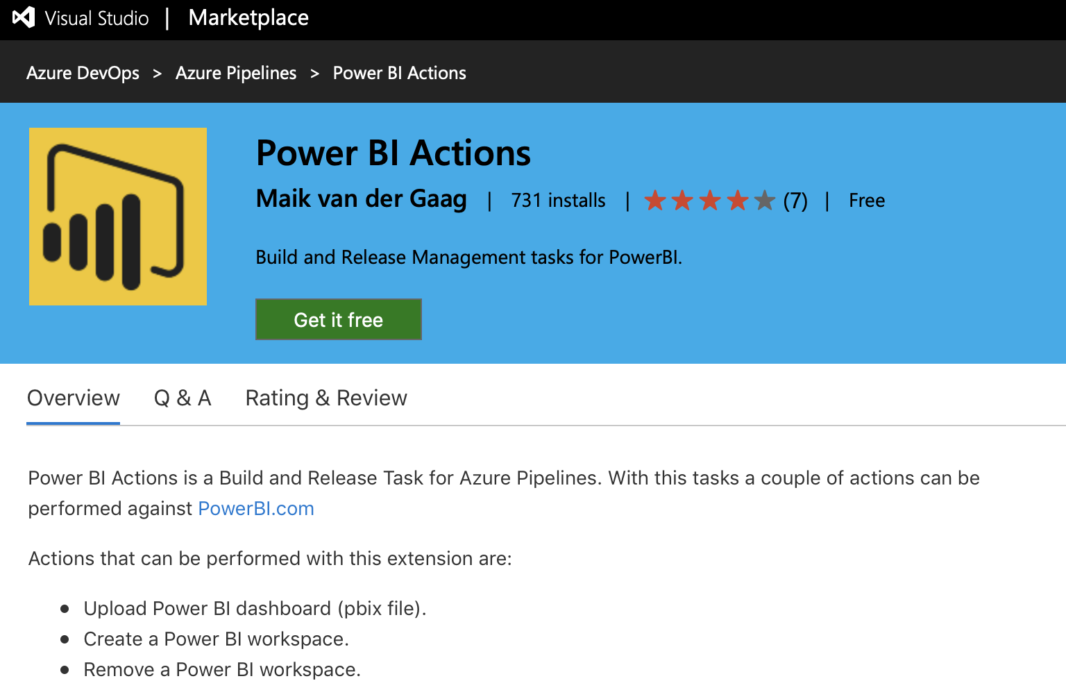
Alternatives?
https://marketplace.visualstudio.com/items?itemName=maikvandergaag.maikvandergaag-power-bi-actions

Slide 41
Demo

Slide 42
Terugblik

Slide 43
Development Seat
Azure DevOps
Deployment Agent
PowerBI.com
Power BI Desktop
Repos
PowerShell
Workspaces
Pipeline
Visual Studio Code

Slide 44
Niet werkende functies
Toevoegen data aan een rapport geïntegreerde dataset
Powershell Cmdlets werken niet met een service app

Slide 45
Vragen?
Yorick Bouma
https://www.linkedin.com/in/yorickbouma
Martijn Veenvliet https://www.linkedin.com/in/martijn-veenvliet-636a4ab4/
Code
https://github.com/yortino/Continuous-Delivery-voor-Power-BI

